Slide 1

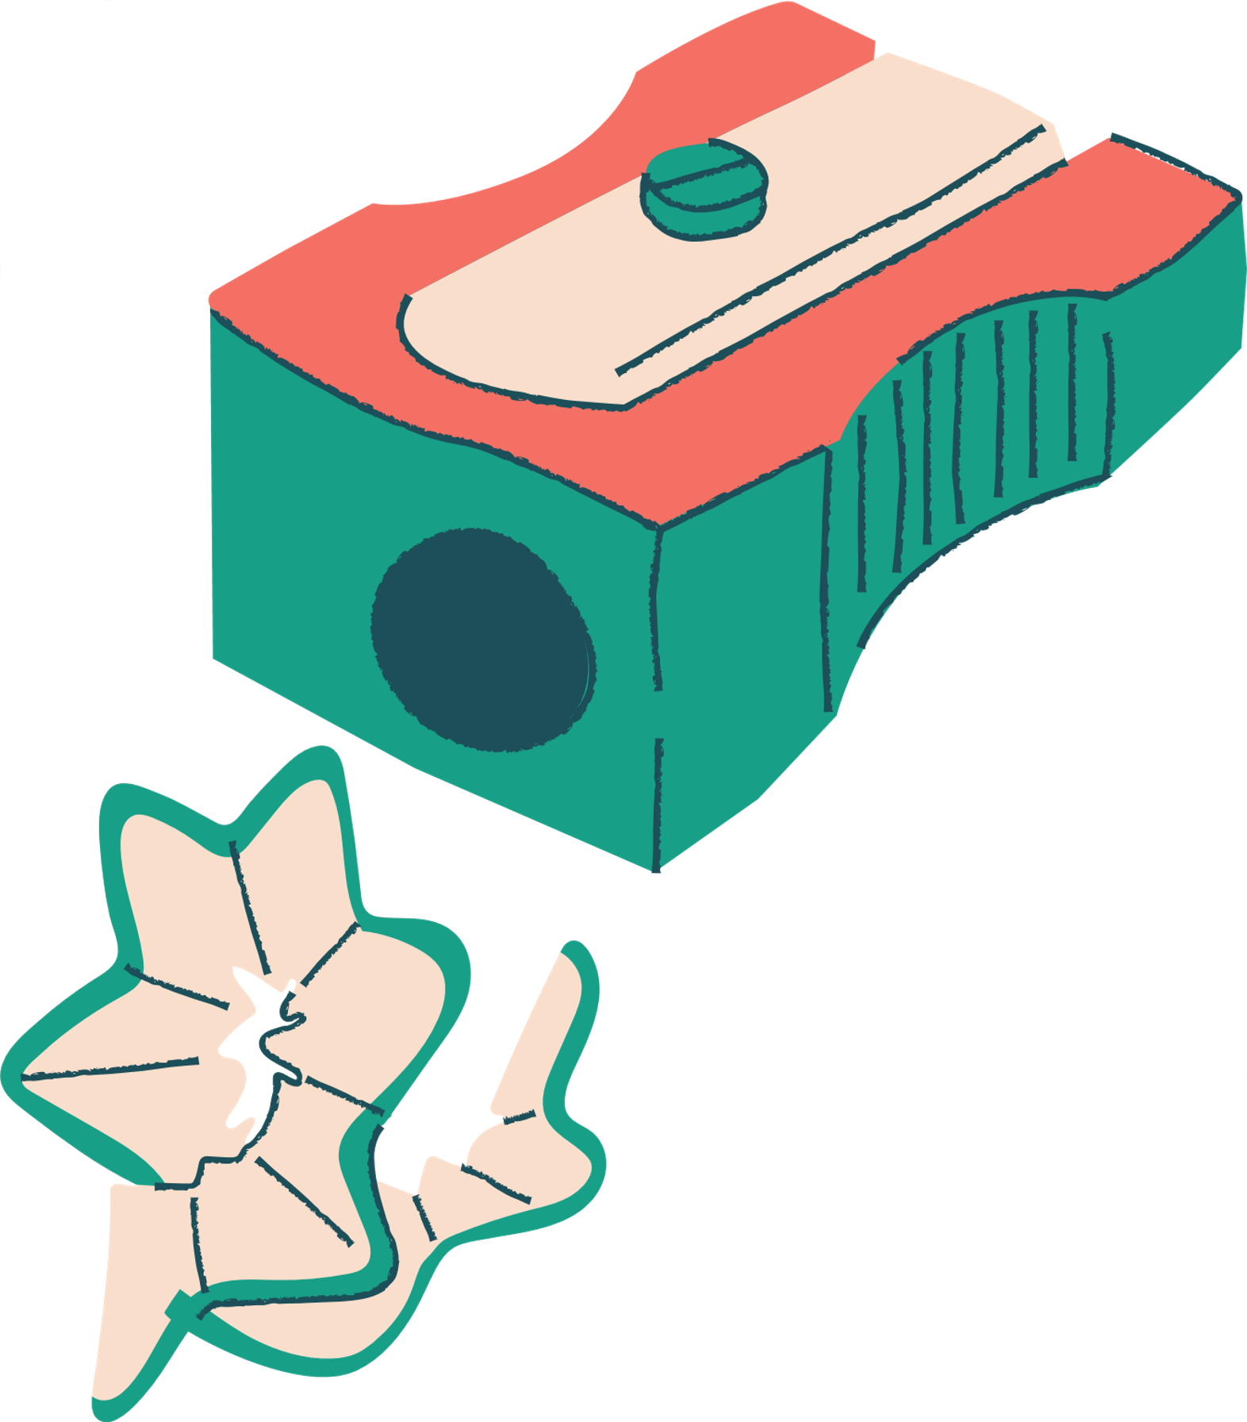



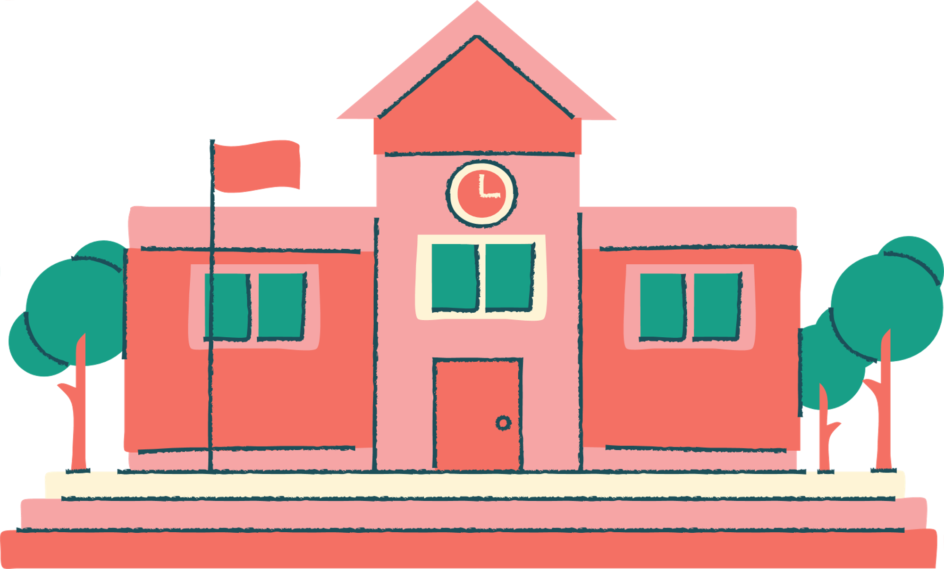
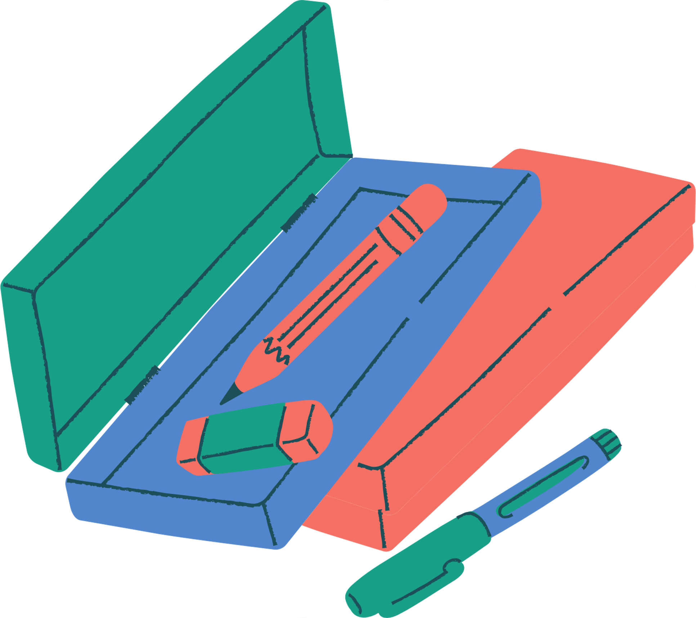
English Year 5
Unit 1 - Towns And Cities

Slide 2


Learning Objectives
By the end of the lesson, pupils will be able to:
Describe appropriately about the places they live.
Listen and fill in the blanks correctly.
Describe places using suitable statements.
Keep interaction going in short exchanges.

Slide 3
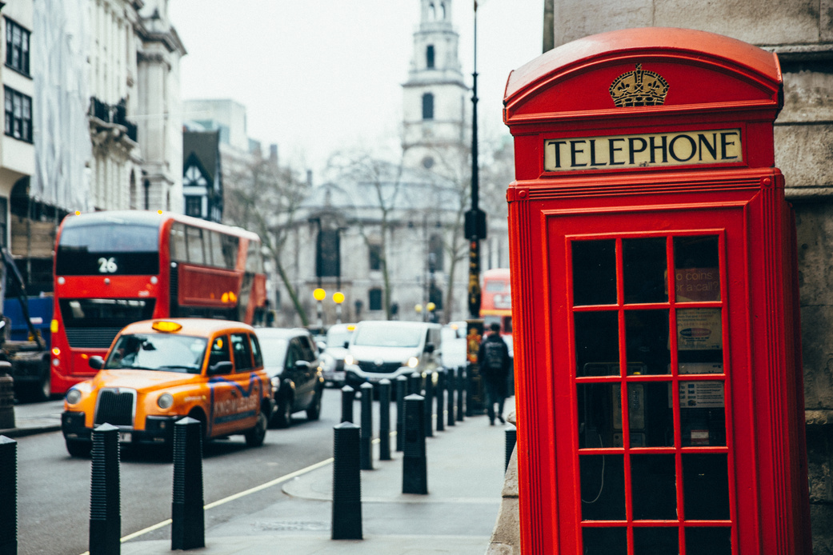
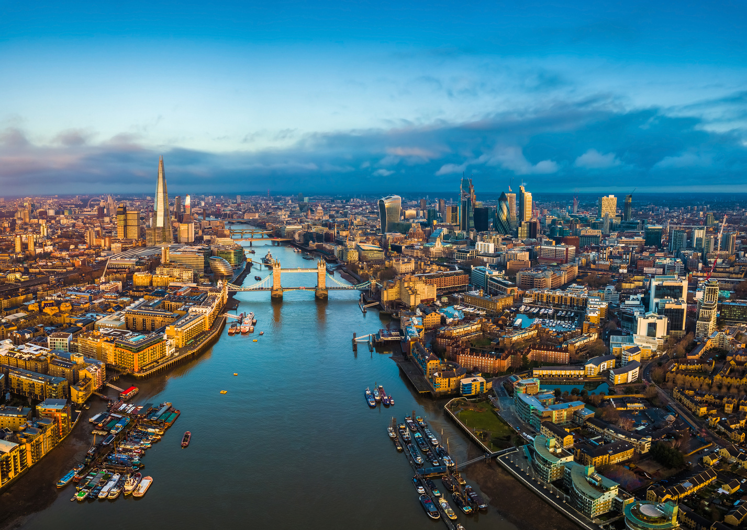
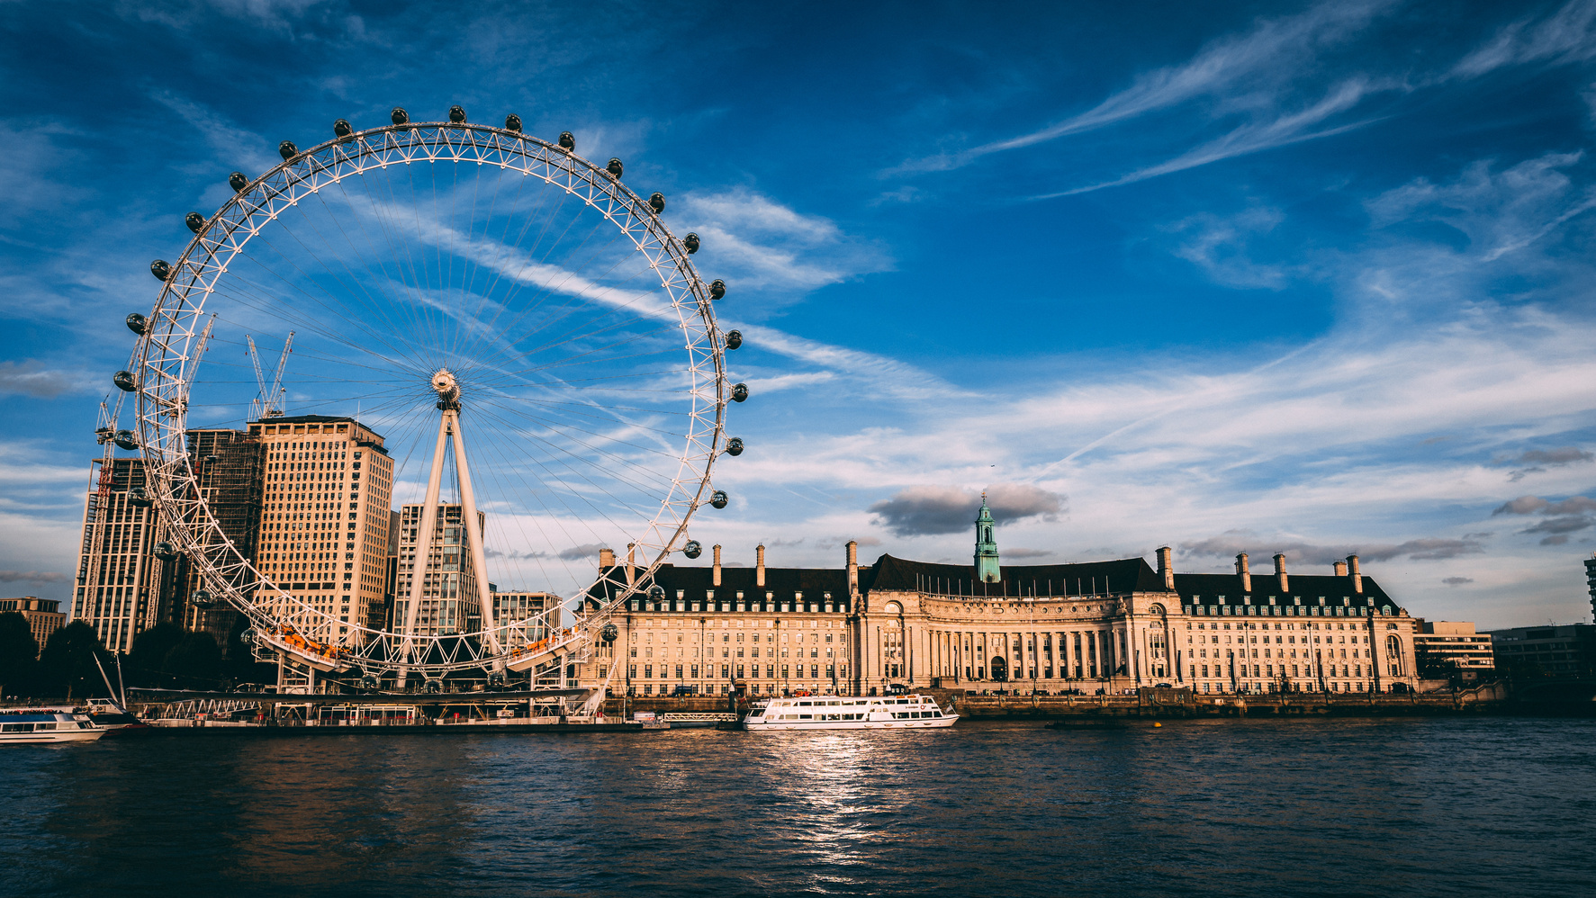
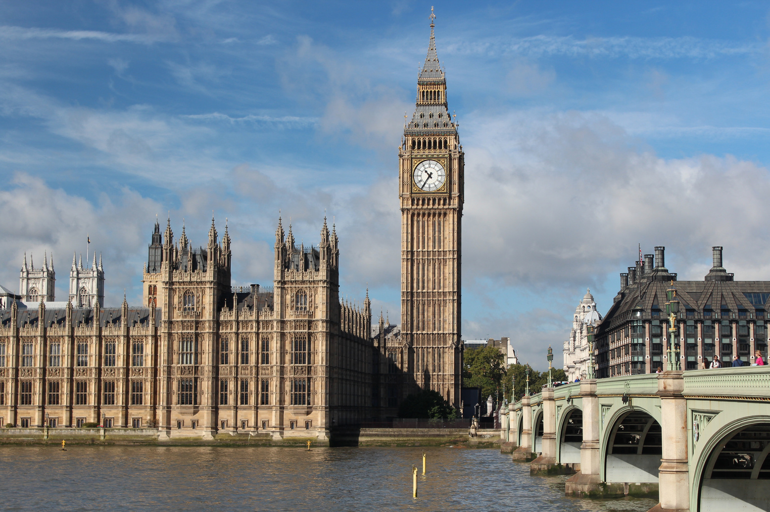
Let's Travel To London
Do you know any of these places?
Have been to any of these places?
Do you know any other interesting towns/cities?

Slide 4
Let's focus on some vocabulary
There's and There are
"There's" is a contraction of "There is" and is used when talking about a singular noun or something that exists.
"There are" is used when talking about plural nouns or multiple things that exist.
Examples:
There's a park in the town.
There are many buildings in the city.

Slide 5
Let's focus on some vocabulary
A and An
"A" and "an" are indefinite articles used before singular nouns to refer to any one of something.
"A" is used before words that begin with consonant sounds.
"An" is used before words that begin with vowel sounds.
Examples:
There's a school in the town.
There's an airport in the city.

Slide 6
Let's focus on some vocabulary
Some and Any
"Some" is used in positive sentences to talk about an unspecified number or quantity.
"Any" is used in negative sentences or questions when we expect a negative answer.
Examples:
There are some shops in the town.
There aren't any museums in the city.

Slide 7

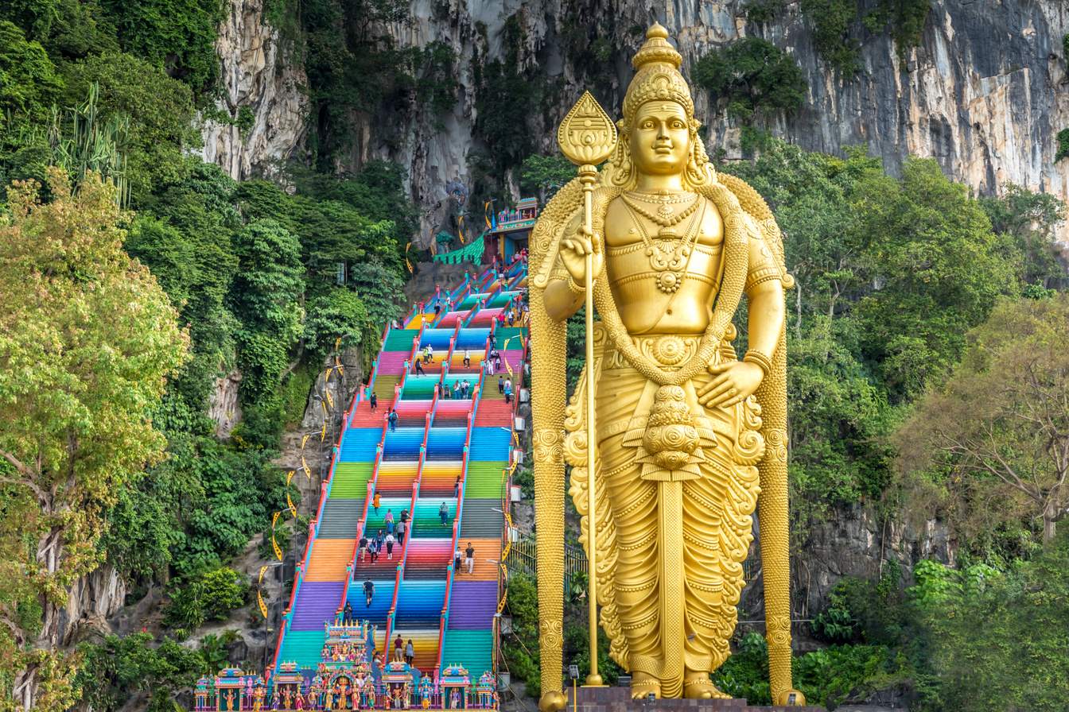
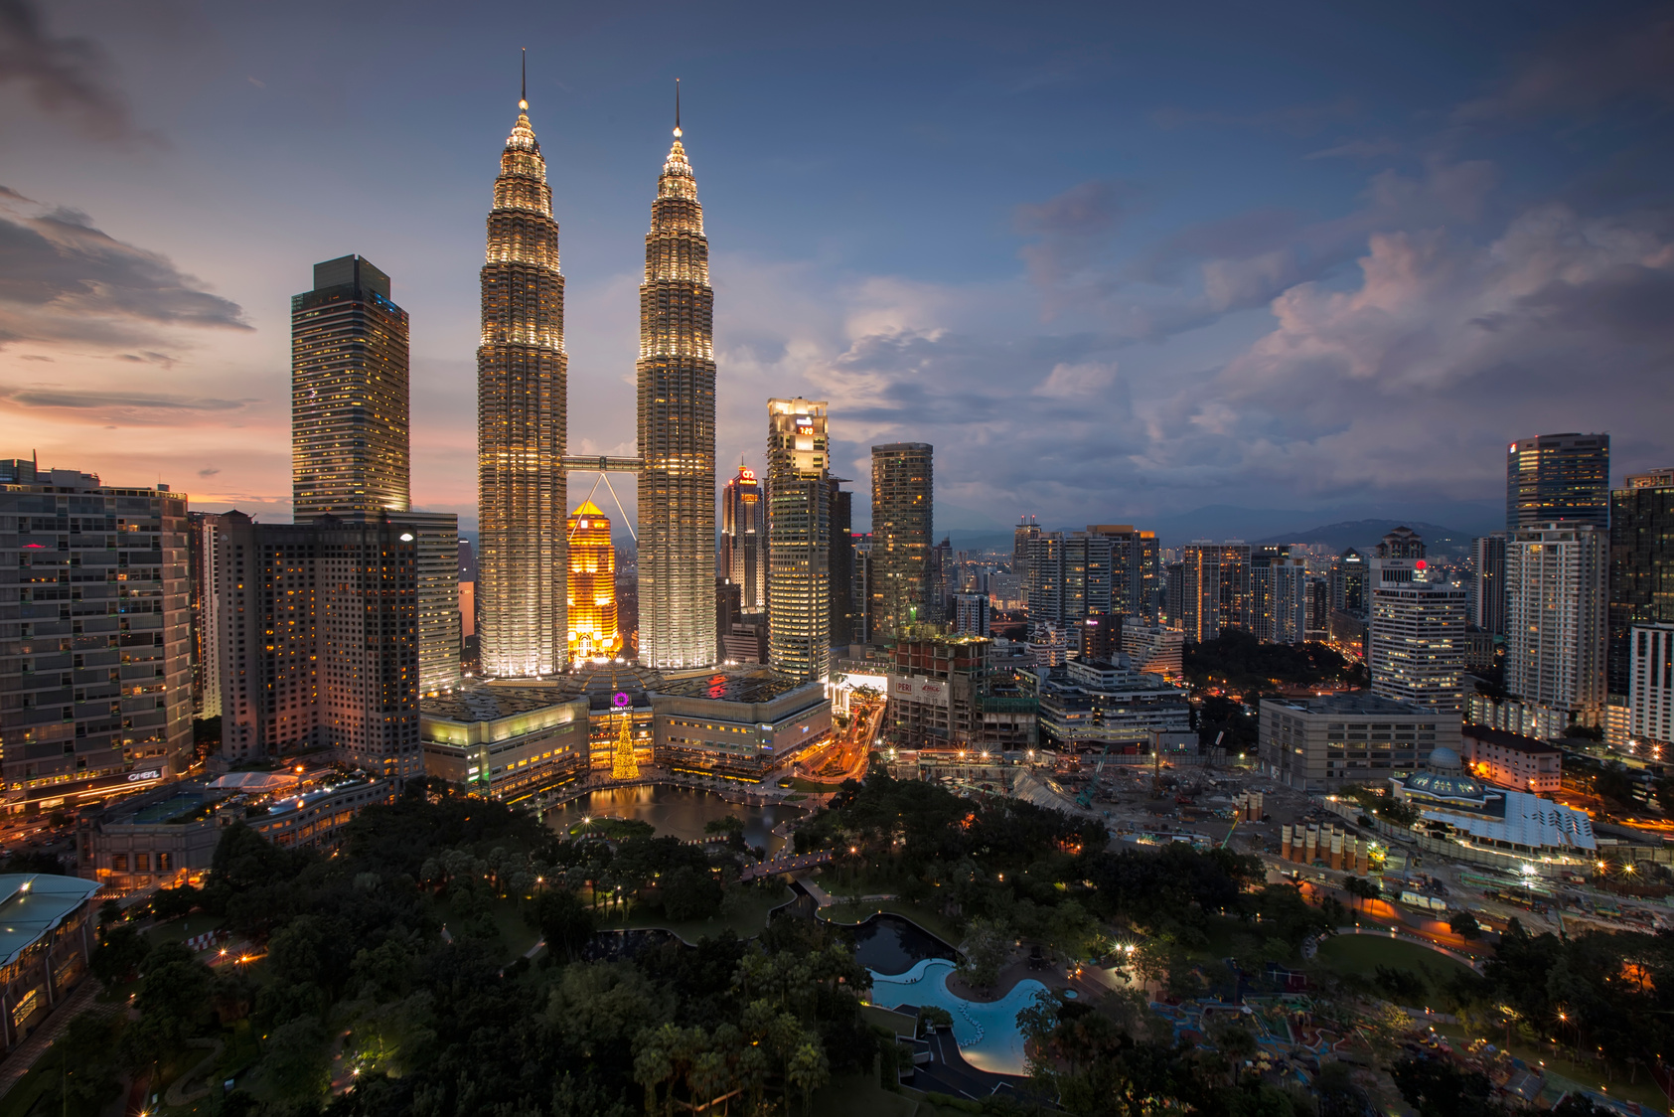
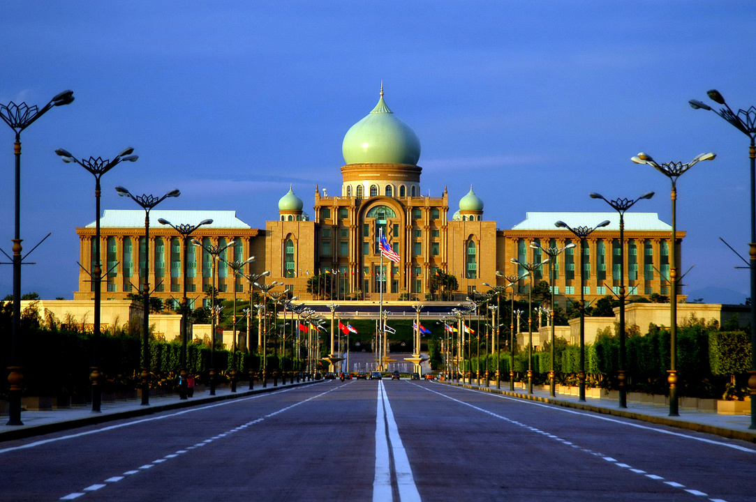
Let's ask and answer a few questions
Simple Present Tense Interrogatives
Interrogative sentences are used to ask questions.
In the simple present tense, we use different question forms to gather information.
Examples:
Is it a park?
Is there a museum?
How many schools are there?

Slide 8


Thank you for
joining today's class.

